Slide 1

The Wondrous World of Restaurant Selection
Leveraging the power of AI generated chatbots to resolve quarrels among family and friends regarding where to eat…
By: Magda Odrowaz, Evan Frank & Adam Brobson

Slide 2
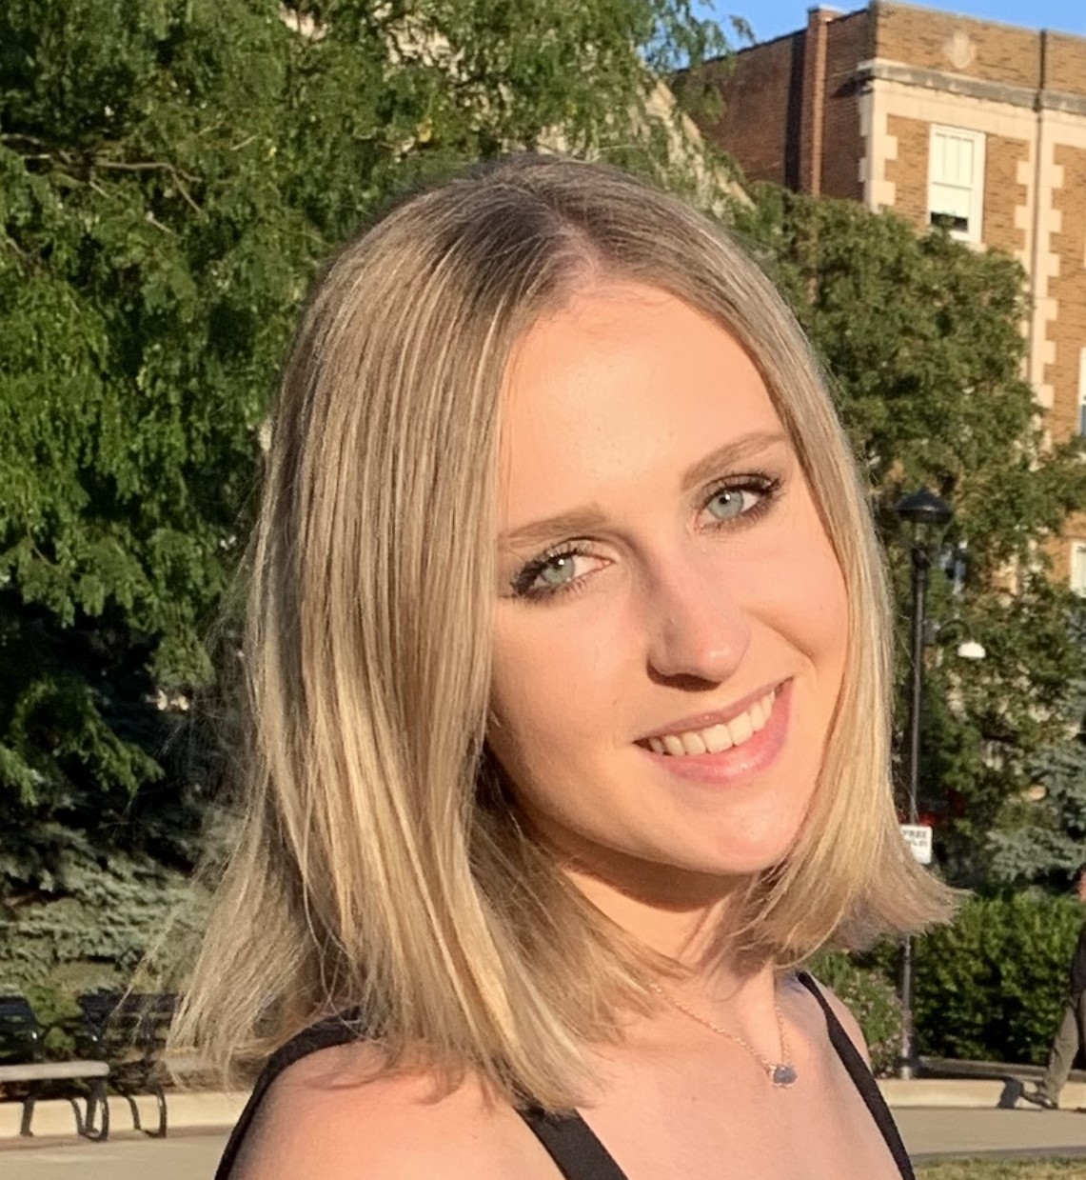
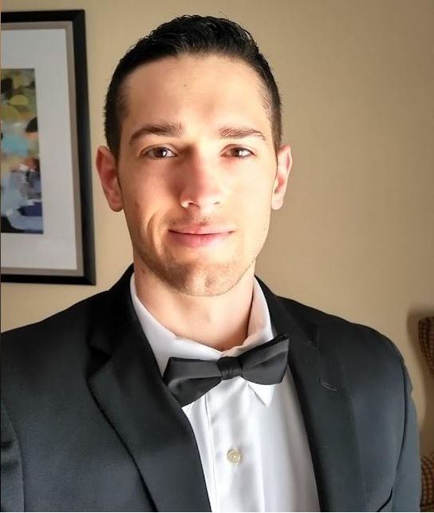

Meet the Foodies:
Magda Odrowaz
Buffalo Grove, IL
B. S. Nutrition ‘22
M.S. Business Analytics ‘23
Adam Brobson
Jenks, OK
B. S. Mechanical Engineering ‘16
M.S. Business Analytics ‘24
Evan Frank
Bainbridge, OH
B. S. Physics ‘21
M.S. Business Analytics ‘23

Slide 3

Disclaimer: The dataset obtained for this project is sourced from Yelp and hosted by Kaggle. The dataset and project ideas have not been used by any of the three members of this group before, however the ALS recommendation model and MySQL has been used by all group members in previous projects and assignments on the Databricks platform.
*Note: This dataset and any information gained from it can not be used for any commercial purposes, however it is appropriate to be used in academic setting such as this one.

Slide 4
Table Of Contents
01
02
Introduction & Data
Chatbot
Restaurant recommender idea and data background.
What questions can the chatbot answer? Detailed overview of Lambda function and ALS model interactions with chatbot.
The Wondrous World of Restaurant Selection

Slide 5

01
Introduction
How we will recommend restaurants.

Slide 6
Have you ever experienced this conversation before?
“Where do you want to eat tonight?”
“I don’t care, where do you want to eat? It doesn’t matter to me!”
“Just tell me where you want to eat, and we’ll eat there.”
The Wondrous World of Restaurant Selection

Slide 7

The Solution
Using the recommending power of the ALS model on the Databricks platform, we will use information such as restaurant reviews and your prior reviews to recommend the perfect restaurant for you or your group via a chatbot!
What restaurant should I eat at?

Slide 8
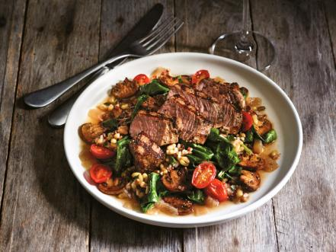
Value
Benefits
Get quality food recommendations by having a chatbot aid in decision making.
Save time and your relationship by finding the right place to eat quickly.

Slide 9
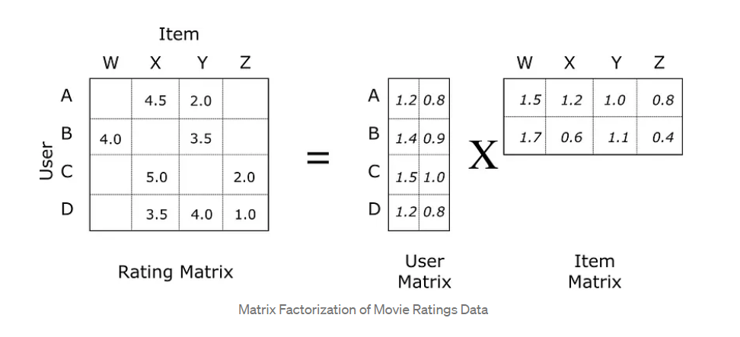
ALS Models
Machine Learning algorithm that uses the power of matrix factorization to handle the sparsity of user, item, and rating matrices to accurately predict user ratings for unrated items.
AKA: Use previous restaurant ratings from a user to predict their top choices of restaurant.
Notes:
Reduce technical jargon

Slide 10
Data Source
269
56,061
≥ 15
Restaurants in Philadelphia, PA
Restaurant reviews total
Reviews for each user in the dataset.
Dataset sourced from Yelp and hosted by Kaggle.

Slide 11
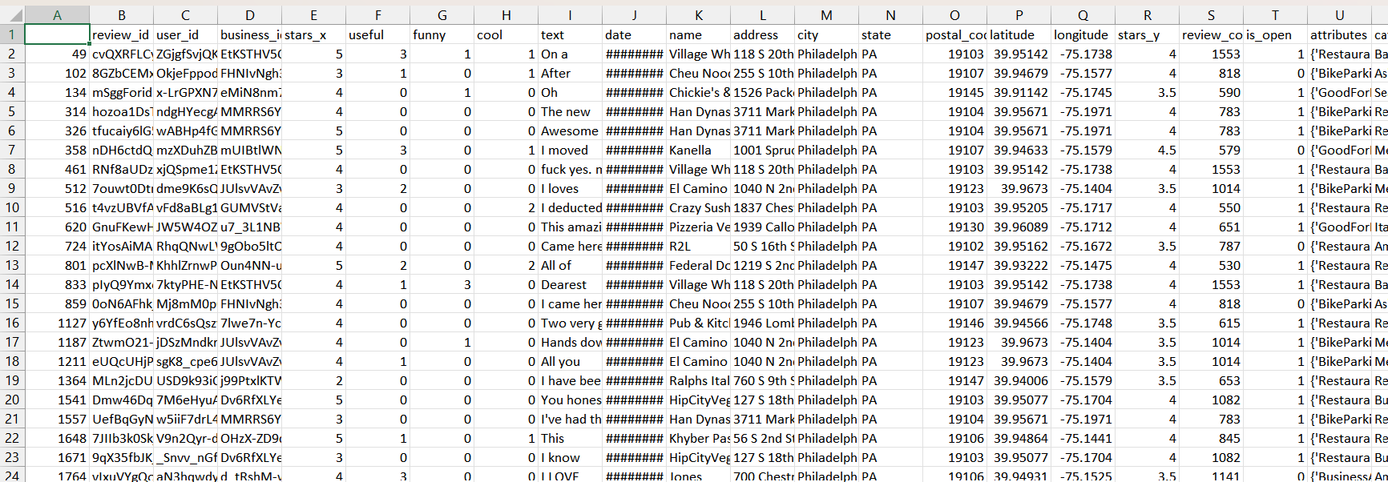
The Dataset
Important features: user_id, business_id, stars_x, attributes, name

Slide 12
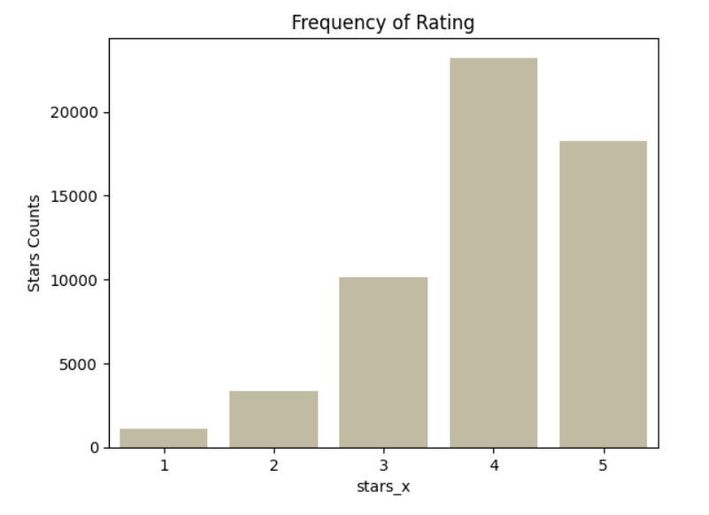
Ratings
The most frequent rating for restaurants in Philadelphia is 4 stars.

Slide 13
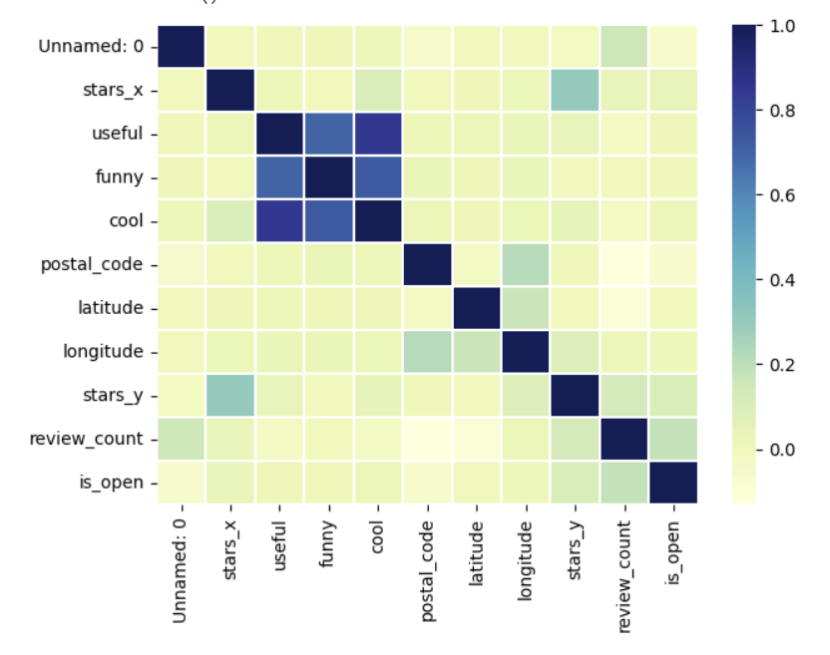
Number of Ratings
Besides theme analysis key words, no other variables used in recommendation have high correlations with each other.

Slide 14

02
The Chatbot & Interactions
Intents and interactions.

Slide 15
Focus on Intents
Leave a review
Recommend a restaurant for me
Make a general recommendation
Use the chatbot to leave a review about a specific restaurant. Adding the review related to your user ID.
Using information such as your own userID, a unique recommendation will be created for you based on your previous preferences.
If you are a new user, or are simply looking for a recommendation that will appeal to the masses, obtain a general recommendation based on desired food genre or meal type.
Notes:
Speak to different lambda function

Slide 16
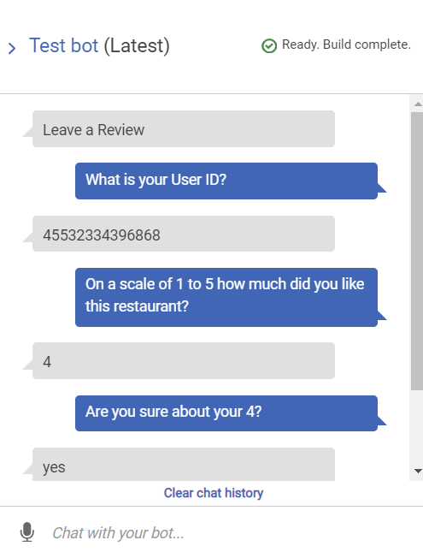
Leave a Review
Sample Utterances:
Leave a Review
Review a Restaurant
Roast a Restaurant
Review
Slots Needed:
What is your user_ID?
User_ID from AMAZON.AlphaNumeric
On a scale of 1-5 how much did you like this restaurant?
Review from AMAZON.AlphaNumeric
Which restaurant is this review for?
Restaurant_Name from AMAZON AlphaNumeric
What date is your review for?
Date from AMAZON Date

Slide 17
Interaction with MySQL and S3 Bucket
Lex Bot
Lambda Function
S3
CSV
Here we collect our users review information
The lambda functions handles the interactions between the Lex Bot and the csv in s3
Our bucket that holds information about our users reviews
The CSV that is updated by the lambda function with our users most recent review
Notes:
Note that the csv is more of a storage bin that holds the csv. The lambda function acts as the middle man that collects all the necessary information to fulfill the intent, then records the latest review on the csv.

Slide 18
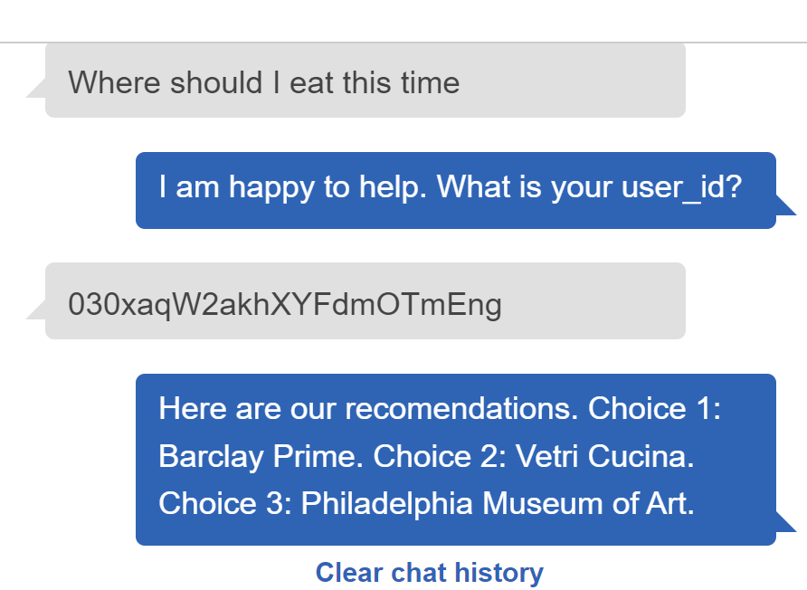
Recommend a Restaurant for Me
Sample Utterances:
Where should I eat this time
What can you recommend for me
What would I like
Slots Needed:
I am happy to help. What is your user_id?
user_id from AMAZON.AlphaNumeric

Slide 19
Interaction with MySQL and Databricks
ALS in DataBricks
Static MySQL Table
Lambda Function
Lex Bot
Create an ALS model and make recommendations for the Top 3 restaurants per user
These static recommendations were put into a table and then placed on a MySQL server for use
Our Lambda Function interacts with our MySQL Table by retrieving our recommendations for a given user_id
The Lex Bot handles gathering our textual information and interacting with our website
Notes:
The ALS Model makes recommendations, stores in MySQL, lambda function passes it to lex, lex then presents to users

Slide 20
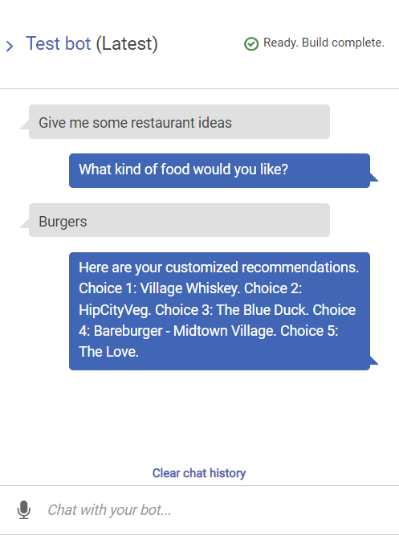
Make a General Recommendation
Sample Utterances:
What do you suggest
Give me some restaurant ideas
Slots Needed:
What kind of food would you like?
genre from AMAZON.AlphaNumeric

Slide 21

Some More MySQL Interaction
Static MySQL Table
Lambda Function
Lex Bot
Export a dataframe to the MySQL with needed fields for the query: categories, name, stars_y
Configure a SQL query to retrieve a list of 5 restaurants that have at least a 4 star rating that fit the desired genre of food.
Obtain the customer’s desired genre to use the SQL query and return a list of restaurants!
Here are your customized recommendations.
Choice 1: Village Whiskey
Choice 2: HipCityVeg
Choice 3: The Blue Duck
Choice 4: Bareburger - Midtown Village
Choice 5: The Love
SELECT DISTINCT name
FROM yelp.gen_rec_restaurants
WHERE categories LIKE '%%{genre}%%' AND stars_y >= 4 LIMIT 5;
Notes:
Only returns 5 restaurants.

Slide 22
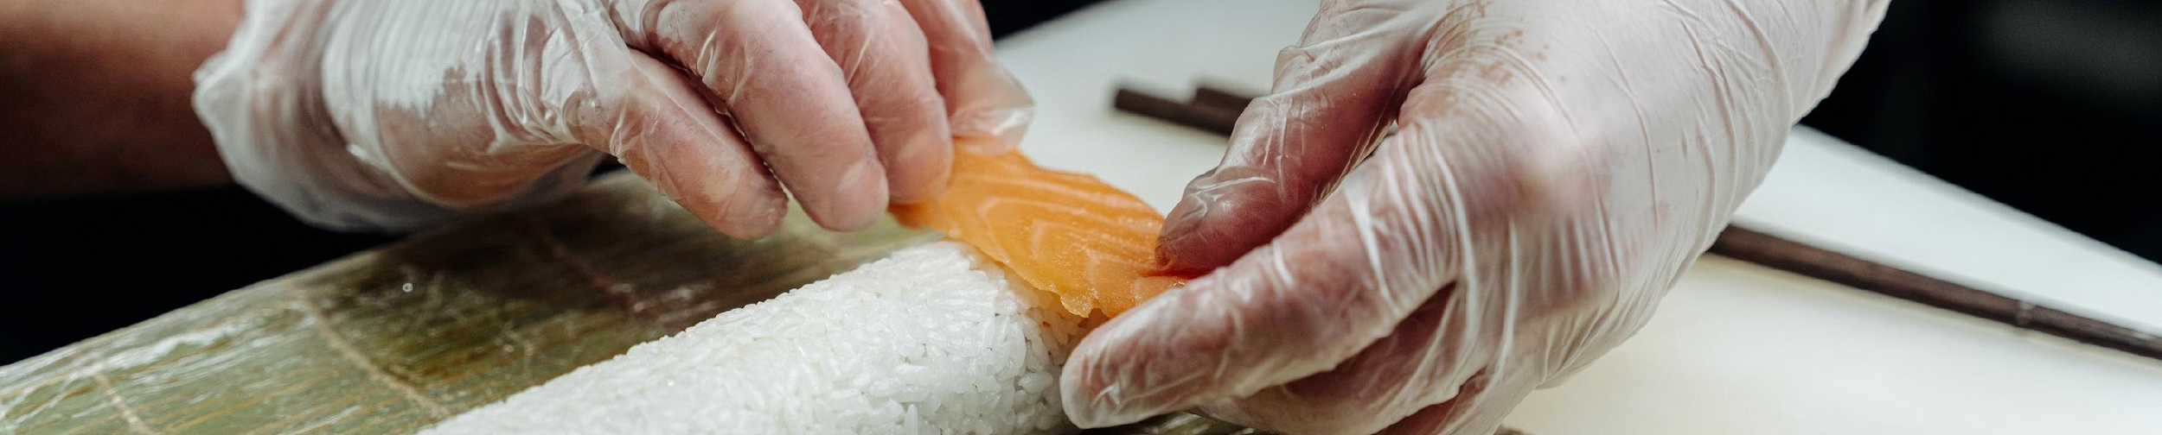

Let’s try out the chatbot!
http://54.237.7.35/
Notes:
030xaqW2akhXYFdmOTmEng

Slide 23

Conclusion
Chatbot Thoughts:
The interactions between our models, Data Storage and Lex were our hardest parts
Optimize for business applications
Expand interactions to improve value provided to customers.
We can not use this data for any non academic setting, new data would need to be found for a real business
The Wondrous World of Restaurant Selection
Notes:
Both in the mysql server and the s3 buckets.

Slide 24

Future Work
Insert username and password instead of user_ID for the ALS model based chatbot
Expand the dataset to cover the U.S. and allow filtering for smaller geographic areas when searching for restaurant recommendations.
More filtering in SQL queries
Deploy the model from Databricks as an endpoint so we can have active user recommendations that are more detailed.
Notes:
Improve useability for travel, more data collection for improved recommendations.

Slide 25
Future Work - Continued
Have new reviews be entered into the dataset used to train the ALS model.
Build interactions into intents to allow reviews to connect to most recently selected restaurant.
Notes:
As part of that process of recommendation improvement, we recommend integrated the stored comments with the pre-existing dataset, so newly collected data can be used to improve the model and recommendations. We’d also like to build in more interactions between intents to improve useability and minimize repetitive data entry.

Slide 26
Questions?

Slide 27
Lex Bot
ALS in DataBricks
Static MySQL Table
Lambda Function
S3
CSV

